Slide 1

OBJECTIVE
The objective of this project is to develop a net banking software that will provide the banking facilities through ATMs or through websites when implemented. The program will be running at the client side as well as on the server site.
NET BANKING
The system keeps all the records of the transaction that are taking place if used in an ATM near future we could increase the security imposed by adding certain features like ”Active Tracing of Fraudulent Behavior , visual sensor and Biometric Identification Procedure”.NET BANKING is not out to change our money habits. Instead ,it uses todays computer technology to give us the option of bypassing the time consuming paper-based aspects of traditional banking in order to manage our finances more quickly and efficiently.

Slide 2
MODULES
Account creation module
Account updation module
Account deletion module
View Account/Report module
Client authentication module

Slide 3

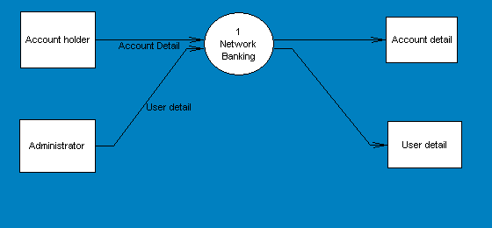

Slide 4
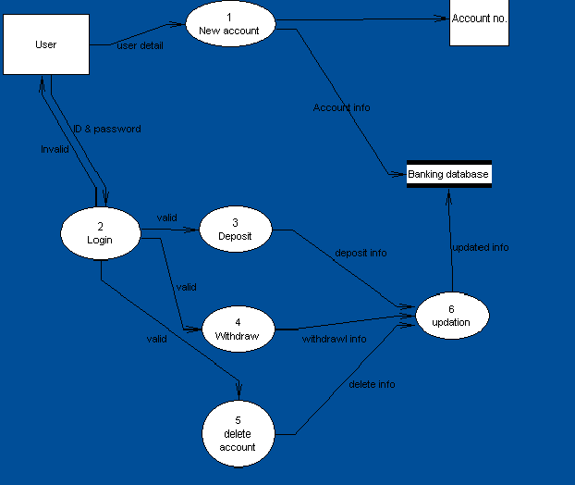
1LEVEL DFD

Slide 5
Adrs.
Age
ER-diagram
name
Can
have
Client
name
Acc. No.
type
Acc. No.
have
Nominee
Adrs.
Age
have
Account
ROI
Rate
Acc. No.
Acc. No.
Account type

Slide 6


Slide 7
Start
select suitable menu item
Is new
acc>>
saving
Yes
Execute new Acc
Saving frm
No
Is new
Acc>>
Recurring
Yes
Execute new Acc
Recurring frm
No
P1

Slide 8
p1
Is new
acc>>
fixed
yes
EXECUTE
New acc. Fixed frm
No
Is
Account>>
delete acc
Yes
EXECUTE
Delete record frm
No
P2

Slide 9
P2
Account>>
Detail all
Yes
Execute Detail All frm
No
Is Edit>>
Record
Yes
Execute edit Record frm
Is edit>>
Change
password
Execute change password
p3

Slide 10
P3
Is
tool>>
view
report
Yes
EXECUTE
Print report.frm
No
Is
withdraw
Yes
EXECUTE
withdrawl.frm
No
Is deposit
Yes
EXECUTE
Deposit.frm
Stop

Slide 11
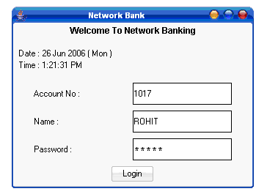
Welcome Form

Slide 12
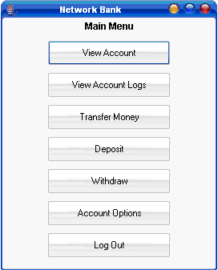
Main Menu Form

Slide 13
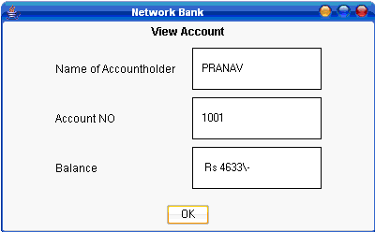
View Account Form

Slide 14
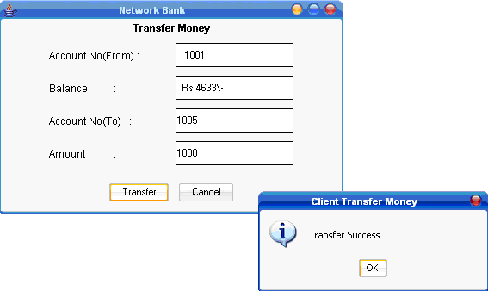
Transfer of Money Form

Slide 15
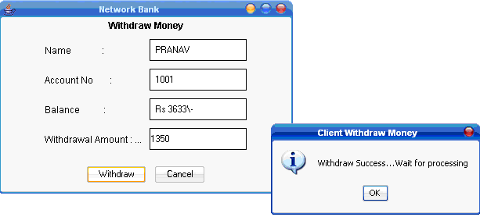
Withdrawal Form

Slide 16
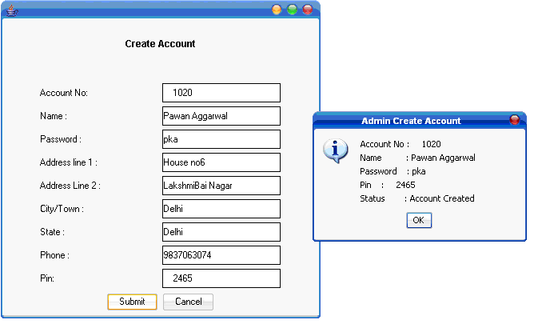
Account Creation Form

Slide 17
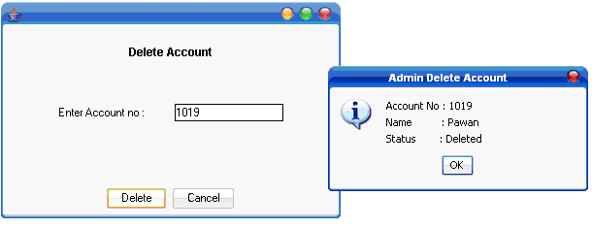
Account Deletion Form

Slide 18
Future Enhancements
Loan Facility.
Email and mobile alerts.
Active Tracing of Fraudulent activities.
Security upgrades like Visual Sensors with burglar alarms, Biometric Identification procedures etc.

Slide 19
CONCLUSION
The aim of our project is to explore new avenues in computing like the distributed system along with traditional concept like OOPs and networking.

Slide 20
1.Complete reference in C++: Sumita Arora
2.Student guide: Windows OS System
3.Internet : Open source
References

Slide 21
THANK YOU

